Slide 1

Title Slide Acumin Pro Extra Cond Bold Italic 60
Subtitle Acumin Pro Semi Cond Bold 22 pt

Slide 2
What is it?
A multi-week engagement effort to support families during the pandemic
  … rapidly built, crowd-sourced by volunteer scientists, extension educators, and graduate students
  … led by College of Health and Human Sciences at Purdue University, with partners across the country (e.g., UCLA, U Illinois, Auburn, Penn State, USUHS)
  … strengths-based
  TAKE ADVANTAGE OF A TEACHABLE MOMENT!

Slide 3
Target Audiences: Military & Civilian
Parents with children
Caregivers of children (and others)
Young adult siblings of children
Older adult relatives of children or parents
Helping professionals

Slide 4
Goals
To help adults and children in families to:
  LEARN about resilience
  GROW their resilience skills
  PRACTICE resilience
  BUILD communities of support

Slide 5
Guiding Framework
Froma Walsh’s Family Resilience Perspective
Why?
This framework is:
  Extremely well-regarded and widely cited by scientists
  Very consistent with available evidence
  Strengths-based
  Inclusive of many types of families and content areas
  Easily modularized
  Intuitively appealing to families – it ‘makes sense’
  Able to be applied from the perspective of many disciplines
Notes:
Froma is willing to help us

Slide 6
Implemented How?
Public facebook group (eventually, a website too)
Each week, a different theme (announced on Saturday)
Each week, a kit with materials tailored for each audience
Special engagement activities throughout the week (e.g., Wellness Wednesday)
Evidence-informed (i.e, family resilience, adult education, psychoeducation, trauma-informed care, behavior change, and online communities)
Designed for convenience:
  Materials can be used at any time, in any order
  Focused on activities of daily life – NOT extra work
  Inclusive of diverse families –military, civilian, farm, special needs

Slide 7
Goals Mapped to Elements
Goal 1: Increase KNOWLEDGE about family resilience.
Addressed by:
  Podcast(s) with experts
  Research summaries
  Expert guidance and resources
Goal 2: Grow SKILLS for family resilience.
Addressed by:
  Success stories from families
  Family activities
  Reflection
Goal 3: PRACTICING family resilience skills.
Addressed by:
  Family activities
  Making positive change
Goal 4: BUILDING a community of support.
Addressed by:
  Community dialogue and sharing

Slide 8
Families Tackling Tough Times Together:
Weekly Themes and Relevant Skills
Week | Label for Theme | Theoretical Domain
1. | Believing, Sharing, Acting | Shared Beliefs; Communication; Organizational Patterns
2 | Our family can do this! | Shared Beliefs: Sharing a positive outlook
3 | Our family is creative! | Communication/Problem solving: Collaborative problem-solving
4 | We care about each other! | Organizational Patterns: Connectedness
5 | Our family will get through this! | Shared Beliefs: Making meaning of adversity
6 | We share our feelings constructively! | Communication/Problem solving: Open emotional expression
7 | Our family is adaptable! | Organizational Patterns: Flexibility to change
8 | We can get stronger! | Shared Beliefs: Transcendance and spirituality
9 | We tell each other the truth! | Communication/Problem solving: Clear consistent messages
10 | We take action! | Organizational Patterns: Mobilizing social and economic resources

Slide 9
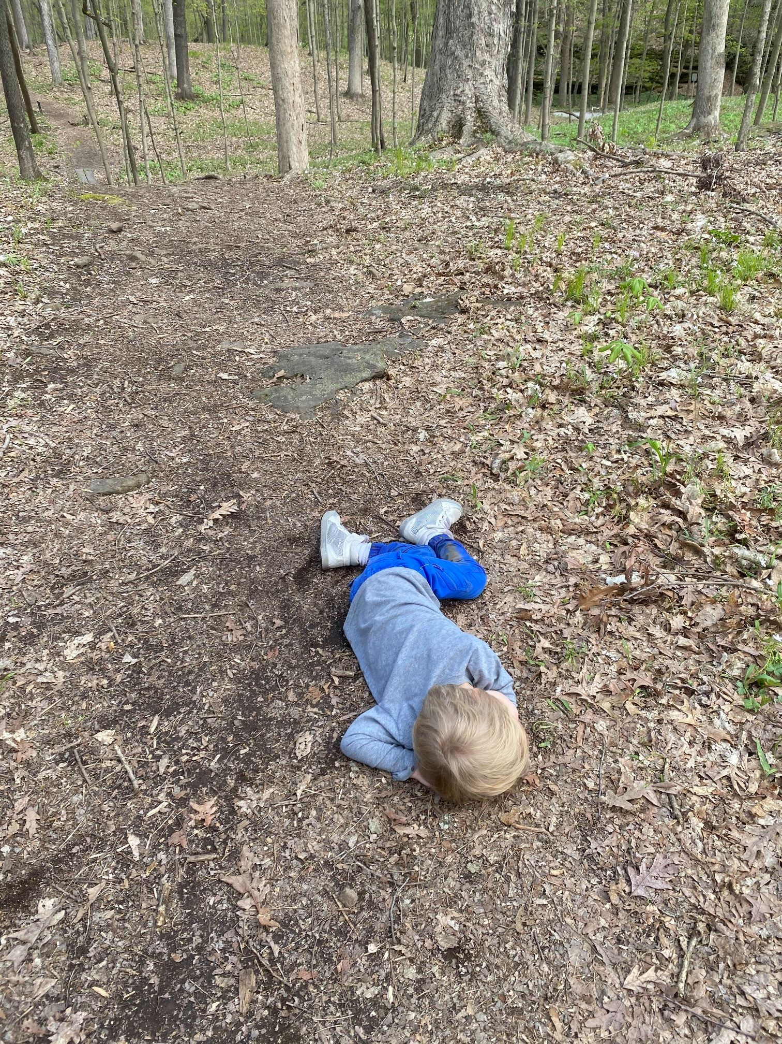
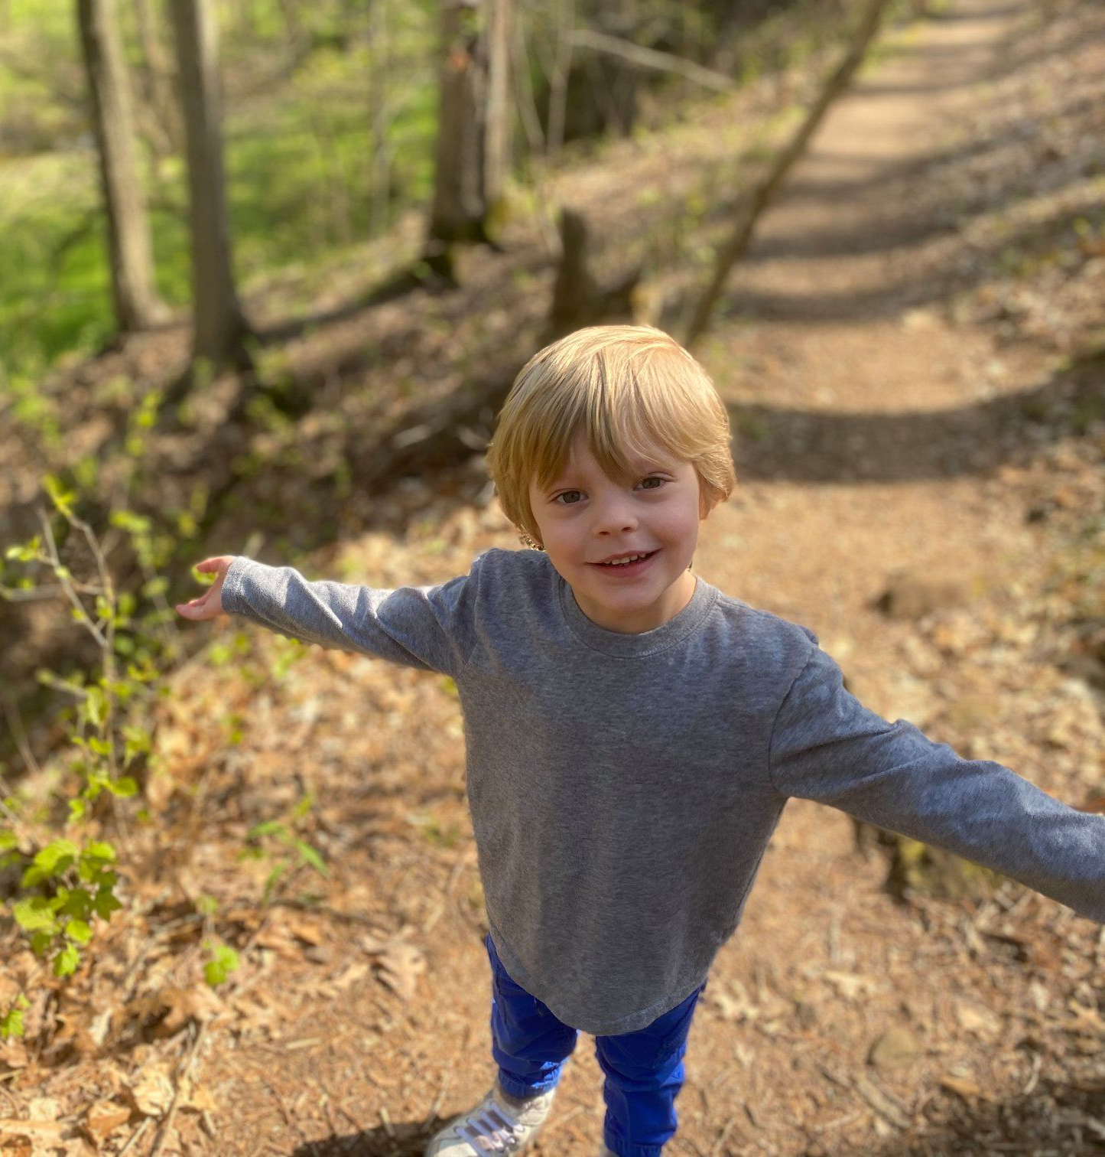
Week 3 For Children:
Collaborative Problem-Solving
“It may not look like it, but this is some collaborative problem solving. My 4yo got tired at the end of our hike. We talked about solutions like me carrying him (not an option because I was already carrying the baby). He came up with the solution of taking a rest and laid down to "fill up his tank." I wasn't wild about him lying all the way down in the middle of the trail, but this was his choice and it worked! He happily made it all the way back to the car after his rest.”

Slide 10
Thank You
Public Facebook group:
  Families Tackling Tough Times Together
  https://bit.ly/HHSFamiliesTogether
Questions:
  Shelley MacDermid Wadsworth, Director
  Military Family Research Institute
  Center for Families
  Purdue University
  shelley@purdue.edu

