Slide 1
Preparing Adults to Be the People Military-Connected Youth Deserve in Their Lives
OneOp
Ken Ginsburg, MD, MS Ed
Children’s Hospital of Philadelphia
The Center for Parent and Teen Communication
Military Child Education Coalition
Covenant House International

Slide 2
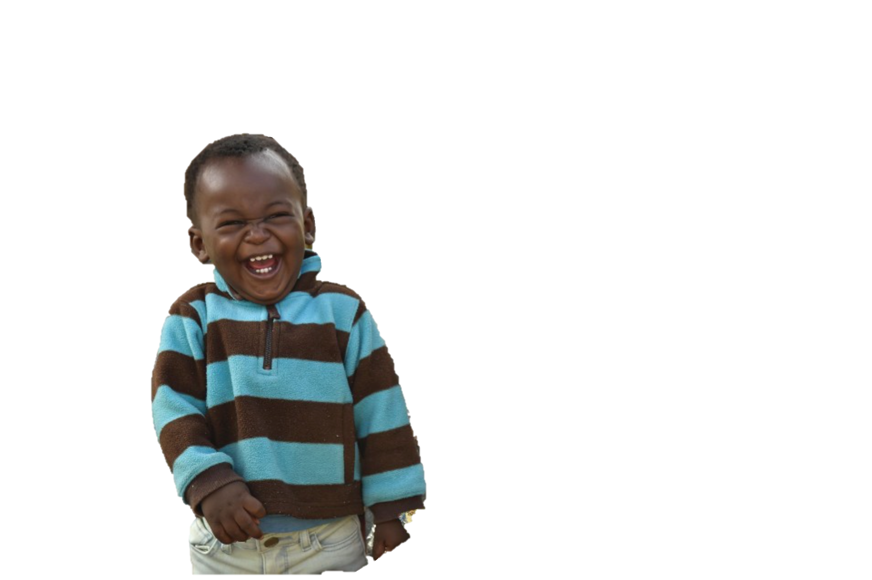

Slide 3
Our Journey Today . . .
Calling out and overcoming the barriers to adult engagement with adolescents
Reinforcing your critical role as guides for adolescents and as thought leaders in how others should support adolescents

Slide 4
Military children are children first
The difference is in
and the predictability of their challenges
the abundance of their strengths

Slide 5
The First Step of Promoting Positive Youth Development: Engaging Adults to be Pro-Development

Slide 6
The Fundamental Questions of Adolescent Identity Development are Well Known
Who am I?
Am I Normal?
Do I fit in?

Slide 7
What is The Fundamental Question Adults Have about Adolescence?
Parents
Do I still matter?
Youth serving professionals and community members
Can I make a difference?

Slide 8
Why are these even questions?

Slide 9
We Must Flip the Cultural Narrative About Teens
Flip
Shifting adolescence from a time to be survived to a time to be celebrated

Slide 10
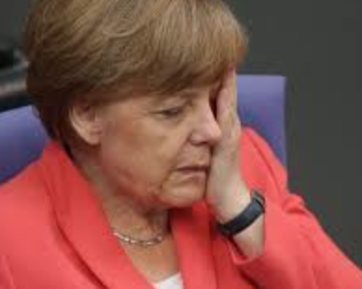
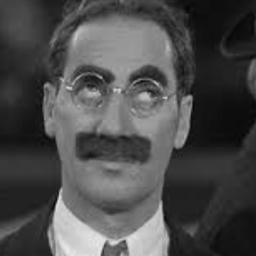
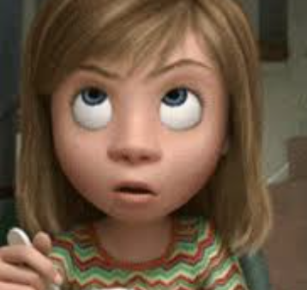
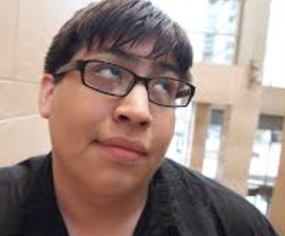

Slide 11
Myths and Misunderstandings that Disempower Parents and Professionals
Adolescents:
Think they are invincible
Are wired for risk
Don’t care what parents think
Can’t be reasoned with
Care about fun not learning
Don’t like adults
Are self-centered

Slide 12
We Have to Share the Truths about Adolescents
Adolescents:
Worry about risk and want adult guidance to stay safe
Are natural experimenters and explore limits to maximize their learning
Care deeply what their parents think and seek role models in their parents and other adults
Can be talked with in a way that optimizes their reasoning abilities
As super learners, optimize experiential learning
Are inherently idealistic and refuse to avert their eyes to injustice

Slide 13
Empowering adult engagement amidst mental-health crisis messaging

Slide 14
We’re Worried About Our Teens
Let’s Offer Hope
Let’s Build Our Skills

Slide 15
Two Things Can Be True at Once
Adolescents are Vulnerable
Adolescents are Inherently Resilient

Slide 16
The Balancing Act

Slide 17
Crisis Signaling

Slide 18
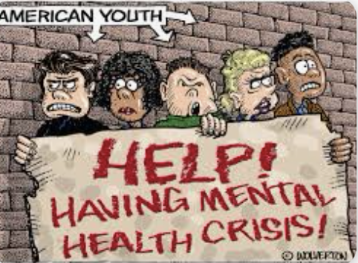

Slide 19
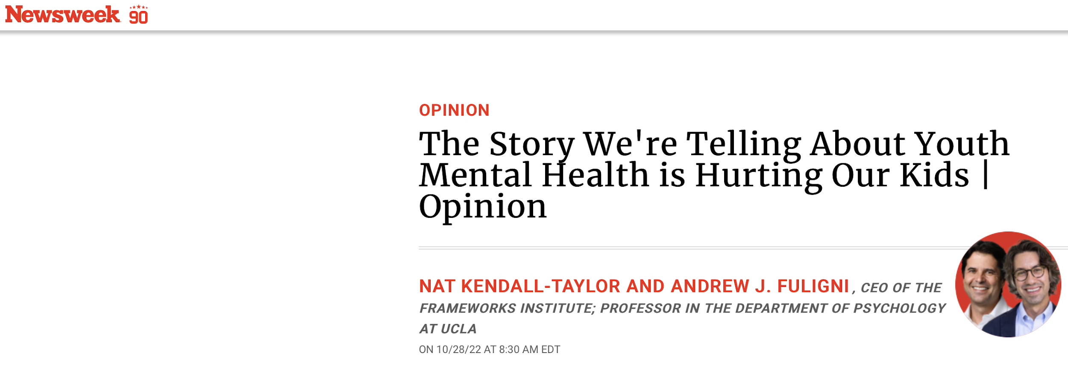
The Results of Crisis Signaling
Paralyzes Action
Reinforces Stereotypes
Focuses on an existing problem instead of facilitating prevention or building youth

Slide 20
The Path Towards Action
Create resources for youth deserving of focused attention
Offer developmental context
Highlight stories of youth resilience and youth contribution
Underscore the potential of this generation
Place blame where it belongs
Offer solutions
Teach how to assess risk and effectively access services
Speak to the power of adult connection and presence
Tell the story of how youth development works
https://www.frameworksinstitute.org/toolkit/the-core-story-of-adolescence/

Slide 21
#StandByTeens

Slide 22
Reframing Marginalized and Traumatized Youth: Helping Adults Grasp The Critical Role of Relationships

Slide 23
Childhood Trauma May Affect:
The Body
The Brain
Behavior
Genetics

Slide 24
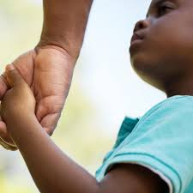
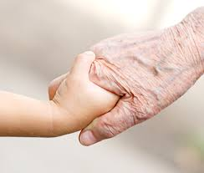
UNLESS

Slide 25
To build strong youth we need to serve them with. . .
A Model that includes all we’ve learned from
Positive Youth Development
Resilience Building Strategies
Trauma-sensitive Practices
Restorative Practices
A model that acknowledges pain, but sees the best in people.
A model that recognizes structural racism and the undermining forces of low expectations, but that prevents a new label from being applied to already marginalized communities. In sharp contrast, it must recognize the inherent strengths of individuals, communities, and cultures.
Notes:
90% of the worlds adolescents live in low and middle income countries. The United States, Canada, Australia, and the collective of European countries represented by EuTeach are the countries with the most active and well resourced multidisciplinary adolescent health infrastructures. As countries like India, Indonesia, and South Africa implement youth friendly services to serve their youth, we are poised to offer adaptable approaches with these three elements in mind.
Lee, Dick etc

Slide 26
At the root of all models is the primacy and power of human relationships both to build strong, successful youth and to heal those who have endured hardships

Slide 27
All Frameworks Combined – No Jargon
We know young people need safe, secure, sustained relationships to thrive. We even know that such relationships can allow them to heal from hard pasts. We must guide them so they are accountable to being their best selves. When we do so, they must know that our high expectations are rooted in our caring. Ideally our efforts at accountability must enhance, rather than disrupt, our protective relationships.

Slide 29
Why the greatest progress with adolescents, but especially for those with the hardest lives, depend on our relationships
Bruce Perry, MD, PH D
Neuro Sequential Model of Therapeutics

Slide 30
Knowing that dose matters and that young people need safe, secure, sustained relationships, we are called to:
Help parents know how much they matter!!! And build within them the power to be the most effective guides in their children’s lives.
Empower extended family and community-based adults

Slide 31
Becoming the Guides Youth Deserve in their Lives

Slide 32
In What Areas Are Military Youth Deserving of Focused Attention?

Slide 33
Military children are children first
The difference is in
and the predictability of their challenges
the abundance of their strengths

Slide 34
The abundant strengths of military-connected youth
Raised in a culture of service and contribution
Often steeped in an authentic community
Raised in a culture of diversity
The military lifestyle, including that of frequent moves, can foster unique social skills, adaptability, and resilience

Slide 35
The predictable challenges military-youth may navigate
The military lifestyle, including that of frequent moves, can lead to disconnection and may be most difficult for youth who are less socially adept
Perfectionism and a desire to spare their parents
Adultification and the loss of childhood
Predictable Stressors associate with parental separation, and even traumatizing news

Slide 36
What we know about promoting relationships and positive behaviors from the parenting research

Slide 37
Balancing Love, Warmth, and Monitoring

Slide 38
“Adulting” Style
Love, warmth and responsiveness
Monitoring, rules and boundaries

Slide 39
Warmth
Rules
Warmth
Rules
Rules
Warmth
Permissive
Balanced
Rules
Warmth
Rules
Warmth
Disengaged
Authoritarian

Slide 40
Effective Monitoring (or, really knowing what’s going on)

Slide 41
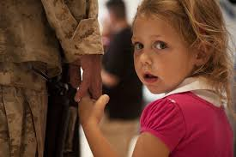
Military children are children first
The difference is in
and the predictability of their challenges
the abundance of their strengths

Slide 42
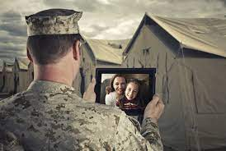
The Language of Love

Slide 43
Brain Development for Communicators

Slide 44
NeuroScience 101
Neuroplasticity – The brain can change and reshape itself – for better or worse – to adapt to its environment.
Adolescence is a time of astoundingly rapid brain growth where brains remain plastic

Slide 45
Emotional centers develop first. (Why?) Development is a process not an event Reasoning ability ALWAYS exists, but is solidifying

Slide 46
The WRONG Way to See It

Slide 47
The Right Way to See It: A Critically Important Opportunity to Enrich and Protect Youth
Adolescents are super-learners
Adolescents are emotionally brilliant, but may not yet have reached the ability to always regulate their emotions.
Experimentation is a necessity, it is our job to create enriching, exciting, safe opportunities for our “natural explorers” to grow.
It is also our job to protect youth from harm

Slide 48
Why super - learners must push the edges. And, our role.

Slide 49
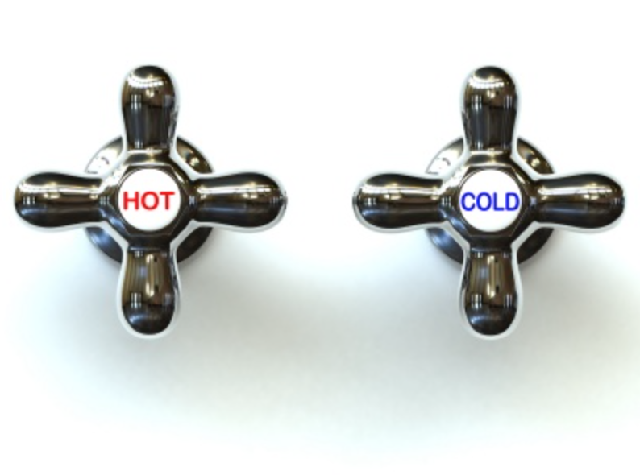
Communication for the Developing Brain (calming emotional reactions – activating reasoning abilities)

Slide 50
Resilience

Slide 51
Resilience
The ability to overcome adversity
The capacity to bounce back

Slide 52
Resilience
To survive difficult times
To thrive in the best of times

Slide 53
Resilience is (partly) a Mindset (Adrenaline)

Slide 54
(Cortisol)
Where’s the tiger now?
Uncertainty may be the greatest challenge to our sense of security

Slide 55
The Bottom Line
Young People will be more resilient if the important adults in their lives believe in them unconditionally and hold them to high expectations

Slide 56
Resilience
is
NOT
Invulnerability

Slide 57
Resilience
can
be
Exhausting

Slide 58
When Resilience Reaches Its Limits
Physical symptoms
Fatigue
Disinterest
Dropping grades
Sad mood
Irritability/anger
Substance use

Slide 59
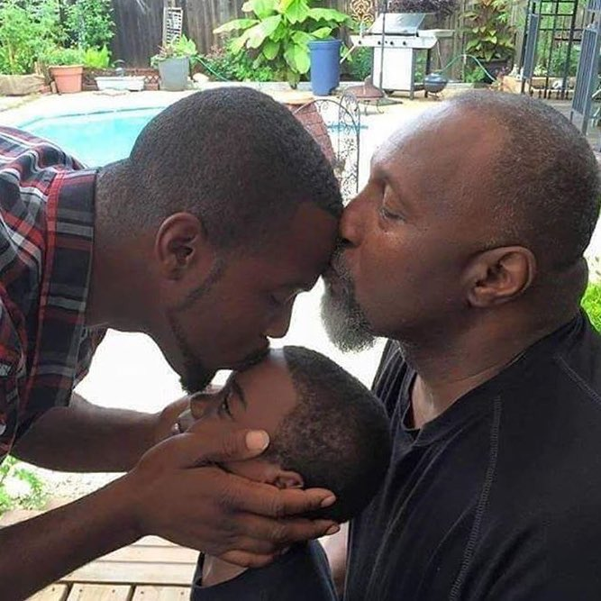
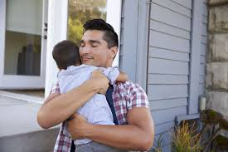
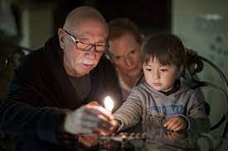
Above all . . . human connection

Slide 60
Trauma-Sensitive Practices

Slide 61
The Effect of Adverse Experiences on Behavior

Slide 62
Key Principles of Trauma Sensitive Practices
Knowing what is about you and what is not about you
Changing your lens from “What’s wrong with you!” to “What happened to you?”
Seeing people as they deserve to be seen, not based on labels they’ve received or behaviors they’ve displayed
Giving control back to people from whom control has been taken away

Slide 63
How Do Hard Lives Make People Experience Transitions Differently? Every new opportunity is a chance to be rejected entirely
Where's the tiger?
Am I safe?
What if I am judged? Will I be rejected?
Should I pretend I don’t care?
Should I fail fast to maintain my control?
Should I choose to fail, so at least I’ll control my destiny?

Slide 64
Working with Youth Who Have Suffered is Not Always Affirming
Youth who need us the most are often those who push us away
Youth who need us the most are often those who push our buttons
Youth who need us the most, raise uncomfortable feelings in us
Youth who need us the most withhold rewards from us.

Slide 65
Nobody dared go near the tower. A fearsome dragon sat on its top.
Until one day, a knight rode up. "Do you need help to get down?"
"Please.”
O. Westin. Micro SF/F Stories

Slide 66
Strength-Based Communication

Slide 67
Strength-Based Communication is NOT Cheerleading
“I need someone who has my back.”
We must Help youth know we’ll be there when they most need us
When praise looks like cheerleading it backfires
Behavior involves forward and backward movement
Make praise about relationship

Slide 68
Strength-based Communication is about battling shame, stigma, and demoralization
It is about listening until genuine strengths are revealed
It is about highlighting and elevating their strengths
It is about recognizing that their potential to overcome challenges is rooted in their existing strengths

Slide 69
Seeing strengths . . . . . . Leveraging strengths to address challenges
X
X
X

Slide 70
“Love is seeing someone as they deserve to be seen, as they really are , not through the lens of the behaviors they have sometimes needed to display.”

Slide 71
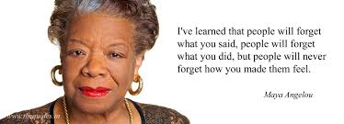

Slide 72
I know you can ____ because you have ____.

Slide 73
Giving Youth Control Over Their Decisions

Slide 74
When we offer choices
When we create felt-safety and coregulate as a path towards clear thinking
When we expand their window of tolerance through the language of resilience
When we help them build stress management skills

Slide 75
Every time we enable the choices that come from clear thinking . . . But how do we get there?

Slide 76
Stress, and coregulation

Slide 77
Good Stress
Helps us handle challenges and allows us to stretch just far enough that we are likely to grow from the experience.
We should support young people with the skill-sets that draw the greatest developmental growth from good stress.
Dr. Bruce McEwen

Slide 78
Toxic Stress
Toxic stress is more than we can handle in a healthy way and is disruptive to our well-being. We must protect people of all ages from toxic stress.
Dr. Bruce McEwen

Slide 79
Tolerable Stress
Tolerable stress is uncomfortable but within our window of tolerance because we can cope with it. What is tolerable is subjective and fluid.
It is in the window of tolerable stress that we can make the difference. It’s about how much someone can handle depending on what else is on their plate and what stress management strategies they possess. The power of coregulation is that caring adult presence changes the equation by making challenges tolerable.
Dr. Bruce McEwen

Slide 80
Calmness, even amidst a chaotic reality, helps youth access their thinking powers and compassionate natures
Co-regulation
Amygdala to amygdala communication
Key to de- escalation
Critical to anticipation
Key to allowing “Mother Teresa” to surface
Self-regulation is a skill to be developed

Slide 81
This is all more important for the youth who has endured hardships or has earned an expectation of rejection

Slide 84
We also help youth self-regulate when they learn to catch their own thoughts

Slide 85
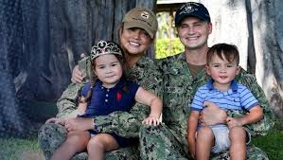
Military children are children first
The difference is in
and the predictability of their challenges
the abundance of their strengths

Slide 86
Because some military children may be set up for perfectionism, learning how to stem negative self-talk and catastrophic thinking is of particular importance

Slide 87
Dialing Down Catastrophic Thought
1.
Recognize negative thoughts. They often begin with phrases like “I better,” “If I don’t,” or “I should.” This is called thought catching.
Stop. Pause. Evaluate thoughts for accuracy.
Develop more accurate explanations when difficult things happen. Take away self-blame.
De-catastrophize. Let go of harmful thoughts that suggest a mistake or failure will lead to inevitable disaster.
2.
3.
4.

Slide 88
Dialing Down Catastrophic Thought
In conversations between adults and youth, we can miss the opportunity for them to learn how to change their thinking patterns.
We focus on the A (“What happened?”) and C (“How do you feel now?” or “What are you going to do?”). We can help them better understand the B connectors - the silent self-talk that drives their beliefs, determines how they interpret situations, and can lead to a calm versus reactive response.

Slide 89
Dialing Down Self-Defeating Thoughts
Self-defeating thoughts often begin with words like “I never” or “I can’t.” This undermines hope. Help teens add the transformative word “yet” to their thoughts.
“I can’t solve this problem” becomes, “I can’t solve this problem yet.” Hope. Then teens can free their minds to make an action plan.

Slide 90
The Language of Resilience . . . . . . offers support while increasing the window of tolerable stress

Slide 91
Although we’d like to protect young people from what might hurt them, the best we can do is prepare them to handle life even when it gets tough.
That means setting aside our instinctual needs to protect them from a momentary challenge, and to instead choose a strategy that prepares them for the future. We do our best when we help them understand they can take control over their own lives.

Slide 92
Words Express How We Think
With our words, we express whether we see youth as vulnerable. Fragile. Incapable. Our language can also state clearly that we think they are safe. Strong. Capable.
When we say to young people, “Let me help you with that,” we communicate “I don’t think you can do it on your own.”
When we say to someone, “It’s not that bad. Let me give you a hug,” we imply comfort relies on us. Rather, we want young people to know the problem is real and that they’ll be able to handle it . . . with our support.

Slide 93
Words Express How We Think
When we jump in with solutions, we deny adolescents the space to arrive at their own. On the other hand, when we listen to them and act as a sounding board, we give them the opportunity to be thoughtful.

Slide 94
Say this . . . When Engaging a Young Person’s Thoughtfulness | Not that . . .
What do you think? I’m here to listen. | I think . . .
Tell me what you understand | You're too young to understand.

Slide 95
Say this . . . about a bad experience | Not that . . .
This must feel awful. In time, it will hurt less. And you’ll be stronger for the experience. | It’s not that bad.
You’ll get through this . . . | I’ll protect you.

Slide 96
Say this . . . about emotional distress | Not that . . .
The best thing about you is how much you care. Your challenge in life will be to learn how to care without hurting too much inside. | You’re too sensitive.
It is great to think as much as you do. Your challenge is to remind yourself you'll be able to handle this; you just have to think through a solution. | You worry too much.

Slide 97
Say this . . . about seeking help | Not that . . .
A strong person learns how to reach out to others. | A strong person handles tough times
It’ll take time. But your own strength and the support you’ll get from those who care about you, will help you heal. | Just get past it.
You deserve to feel better. | You need help

Slide 98
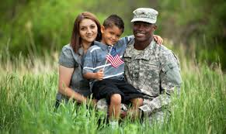
Military children are children first
The difference is in
and the predictability of their challenges
the abundance of their strengths

Slide 99
Because some military parents may be overloaded it is imperative that parents understand:
Why self-care makes it more likely their children will come to them
To learn the ”Don’t Spare Me” Conversation

Slide 100
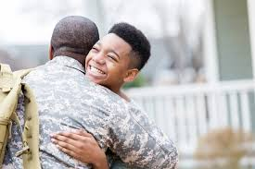
Military children are children first
The difference is in
and the predictability of their challenges
the abundance of their strengths

Slide 101
Military-connected children have all the stressors of every child, as well as those associated with frequent moves, the deployment cycle, and exposure to tragedy

Slide 102
Every time we enable positive choices to manage painful or stressful realities

Slide 103
Stress Management and Resilience
Is about learning to cope, in a positive way with life’s inevitable stressors
People who can choose positive coping strategies gain control

Slide 104
Relief
Relief
Positive Coping Strategies
You Feel Awful!!!
You Feel Awful!!!
You Feel Awful!!!
Stress
Discomfort
Discomfort
Discomfort
Negative Coping Strategies

Slide 105
Relief
Relief
Positive Coping Strategies
You Feel Awful!!!
You Feel Awful!!!
You Feel Awful!!!
Stress
Discomfort
Discomfort
Discomfort
Negative Coping Strategies

Slide 106
A Comprehensive Stress Management Plan Includes:
Problem-Focused Strategies
Emotion-Focused Strategies
Strategies that Integrate the Mind and Body
Strategies that Build a Sense of Meaning and Purpose

Slide 107
www.parentandteen.com

Slide 108
Almost done!!

Slide 109
How will we judge our success?
Through easy measurements: grades, jobs, graduations, suspension rates . . . And mental health rates
But mostly in vital ways not easily measured . . .
By making it so young people can safely experience their feelings
By helping young people experience people are worthy of trust
By helping young people know they are worthy of being loved

Slide 110
How will we judge our success?
By launching ALL young people into adulthood knowing they are ok . . . Just the way they really are . . .

Slide 111
How will we judge our success?
By sharing the truth about who young people really are and thereby . . .
empower and activate parents, and
create a different reality for our students when they navigate the world outside of our settings.
#StandByTeens

