Slide 1
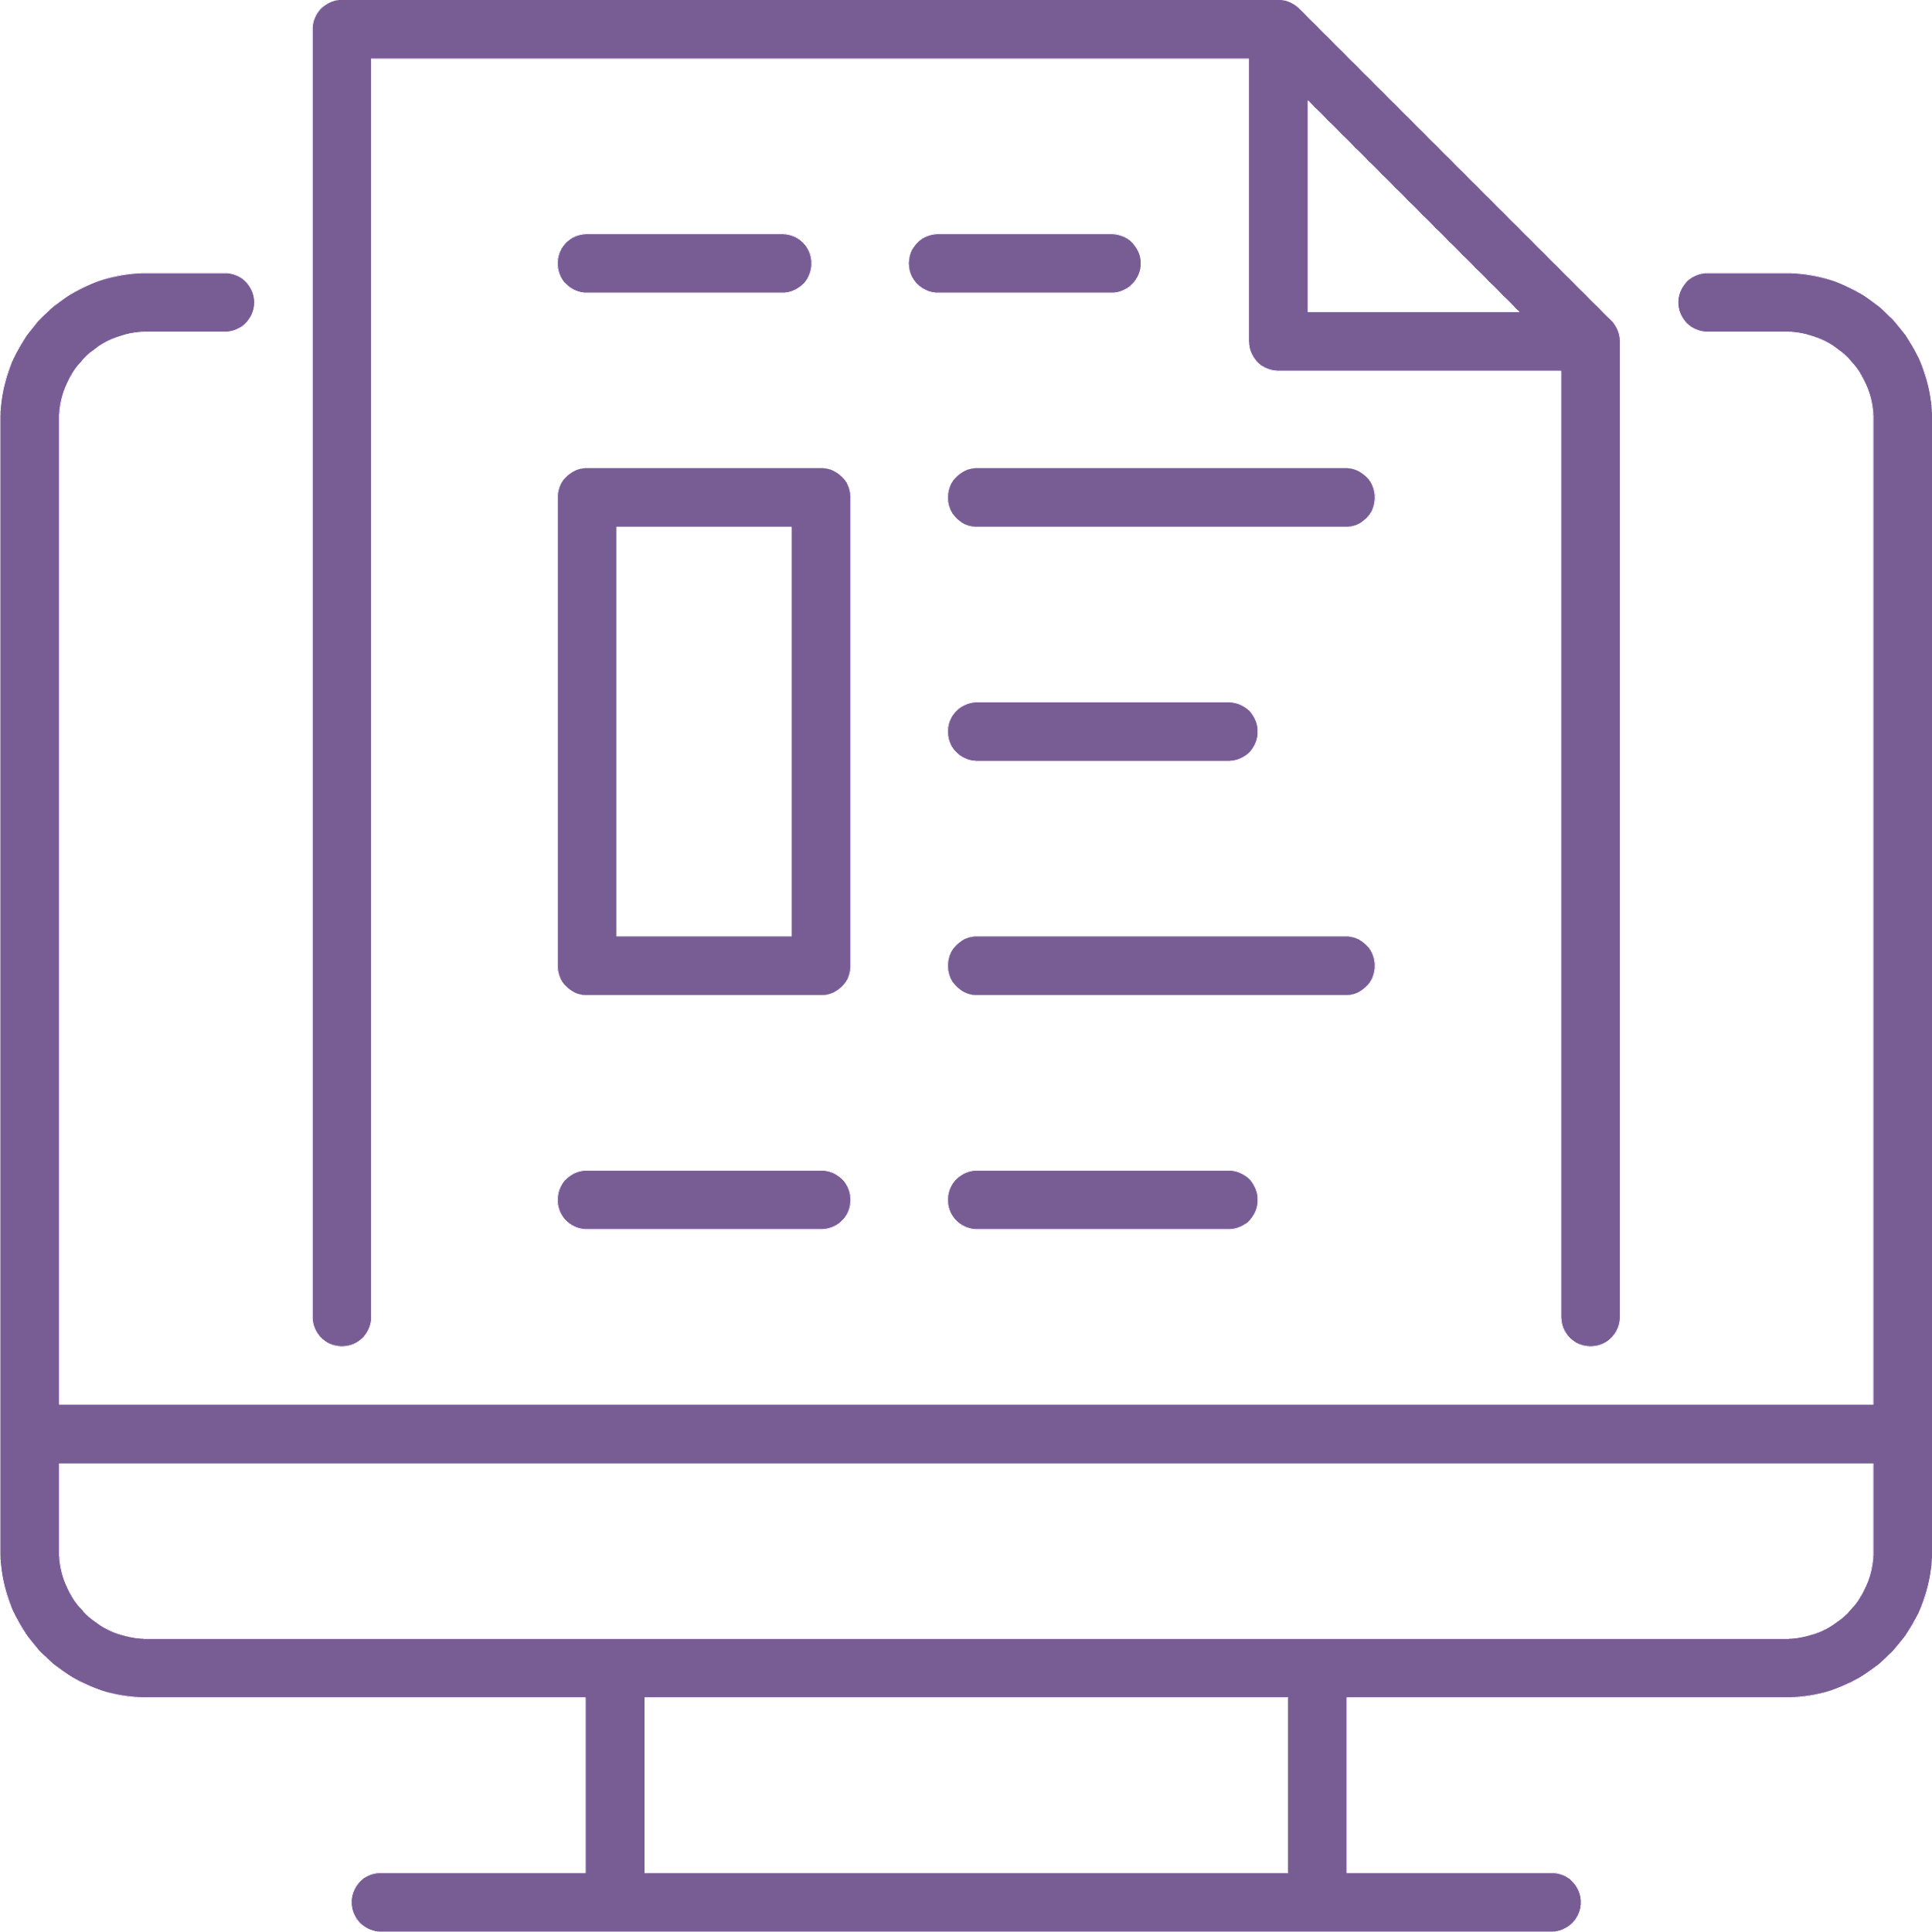
Welcome!
Visit the event page to download a copy of the webinar slides and any additional resources.
Select ‘Everyone’ from the drop-down menu when commenting in the chat pod.
Email us if you need tech support or have questions.
Contact@OneOp.org
OneOp.org/learn/160031/

Slide 2
Federal Student Aid: Repayment 101

Slide 3
Federal Student Aid: Repayment 101
Event Materials
Visit the event page to download a copy of the presentation slides and webinar resources.
Continuing Education
This webinar has been approved to offer continuing education credit. Please stay tuned until the end for CE information!
OneOp.org/learn/160031/

Slide 4
This material is based upon work supported by the National Institute of Food and Agriculture, U.S. Department of Agriculture, and the Office of Military Family Readiness Policy, U.S. Department of Defense under Award Numbers 2019-48770-30366 and 2023-48770-41333.
OneOp.org

Slide 5
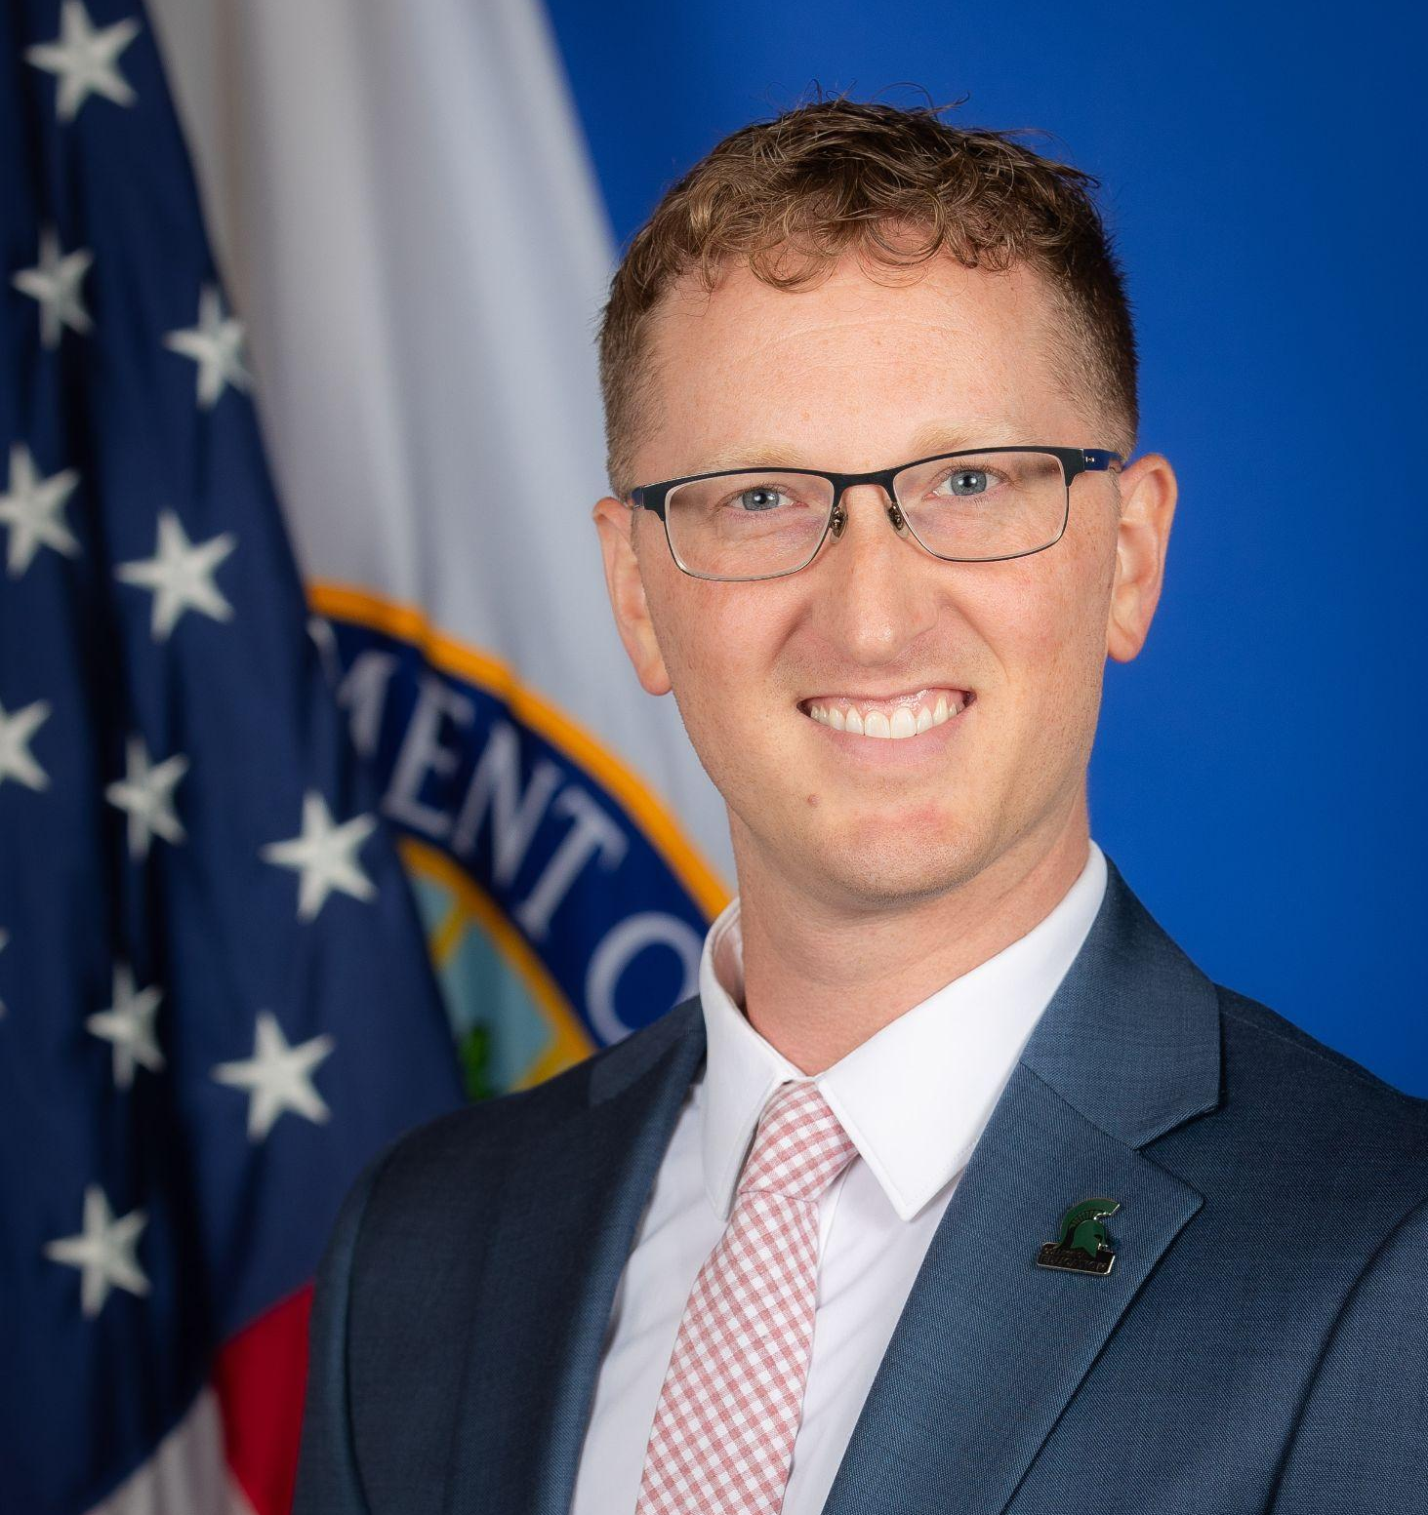
Today’s Presenters
Bradley D. Custer, Ph.D.
Kalynn Wollard
Analyst, Stakeholder Engagement Group
Student Loan Ombudsman’s Office
Federal Student Aid
Program Coordinator, Stakeholder Engagement Group
Student Loan Ombudsman’s Office
Federal Student Aid

Slide 6
FEDERAL STUDENT AID: REPAYMENT 101
Stakeholder Engagement Group
Ombudsman Office
Information presented today is on background and not for direct attribution. For comment about the information presented today, please contact press@ed.gov..

Slide 7
PRESENTATION
Student Loan Overview
FSA ID
Income-Driven Repayment (IDR) Plans
Saving on A Valuable Education (SAVE) Plan
Payment Count Adjustment
Loan Consolidation
Public Service Loan Forgiveness (PSLF)
Parent PLUS Loans
Fresh Start
Q&A
Contact Information

Slide 8
STUDENT LOAN OVERVIEW

Slide 9
TYPES OF FEDERAL STUDENT LOANS
Direct Loans: The most common type of federal loan. These loans are made directly by the Department of Education and serviced by one of four contracted companies— Aidvantage, EdFinancial, Nelnet, or MOHELA (Missouri Higher Education Loan Authority).
Federal Family Education Loans (FFEL): Older federal loans (made before 2010) that were originated by banks and other financial institutions and insured by the Department of Education. Some of these loans are now owned by the Department.
Perkins Loans: Loans made by colleges to students with exceptional financial need. The Perkins program ended in 2017, and the Department owns some of these loans now. Perkins loans are eligible for unique loan forgiveness programs.
Borrowers can find out what type of loan they have by visiting StudentAid.gov dashboard or calling their servicer.

Slide 10
RETURN TO REPAYMENT CHECKLIST
Update contact information
Explore affordable repayment plans
If on an income-driven repayment (IDR) plan, consider recertifying
Enroll (or reenroll) in auto pay
Know the monthly payment amount
Make payments
Check for eligibility for loan forgiveness
Restarting Student Loan Payments | Federal Student Aid

Slide 11
STUDENT LOAN SERVICERS
A loan servicer is a company that we assign to handle the billing and other services on federal student loans on our behalf, at no cost to the borrower.
The loan servicer will work with borrowers on repayment options (such as income-driven repayment plans and loan consolidation) and will assist with other tasks related to federal student loans.
Loan Servicers
MOHELA (PSLF, TEACH)
Nelnet
Aidvantage
Edfinancial
ECSI (Perkins Loans)
Default Resolution Group (defaulted loans)
CRI (new servicer)

Slide 12
BEWARE OF SCAMS
Borrowers never have to pay for help with your FAFSA or federal student loans.
Make sure to understand which companies and claims are legitimate.
Alert: A number of offers for financial aid or help (such as a “pandemic grant” or “Biden loan forgiveness”) have circulated during the coronavirus pandemic.
Avoiding Student Aid Scams | Federal Student Aid
Play It Safe: Protect Yourself From Student Loan Scams (youtube.com)

Slide 13
MANAGING YOUR FSA ID

Slide 14
STUDENTAID.GOV
Visit Home | Federal Student Aid for:
Information about student financial aid
Apply for aid with the FAFSA (Free Application for Federal Student Aid)
Manage student loans
Identify loan servicers
Consolidate loans
Apply for PSLF
Log into account using FSA ID
Log In | Federal Student Aid

Slide 15
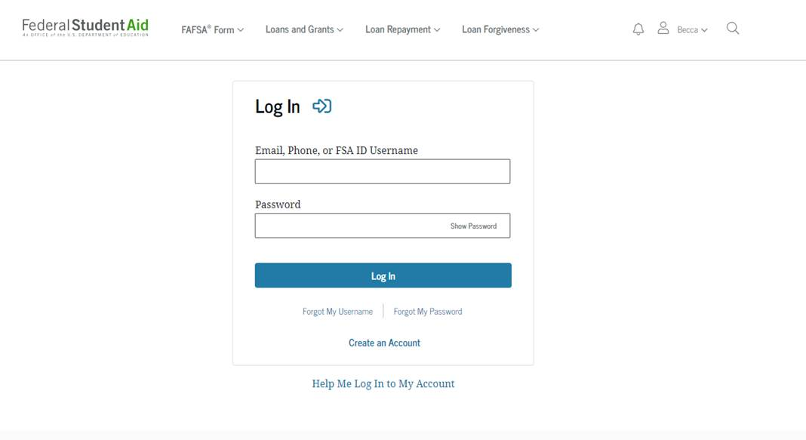
LOGGING IN WITH THE FSA ID
When logging in, if the borrower forgets their FSA ID username, they have the option of using the email or phone number attached to their account instead.

Slide 16
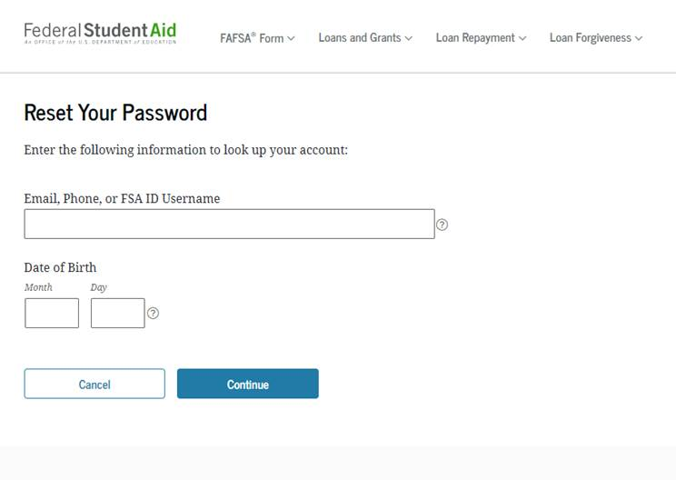
RETRIEVING FSA ID PASSWORD
If the borrower needs to reset their password, they can provide information to verify which account information they’re requesting.
Once the borrower hits continue, they can complete the password reset with either a two-factor authentication code sent to either the email address or phone number on record, or by answering their challenge questions.

Slide 17
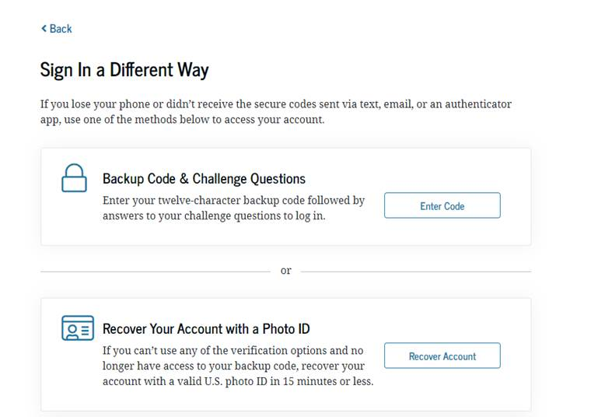
ALTERNATE: RETRIEVING FSA ID
If the borrower cannot recover their password or username with the prior options:
The borrower can select the option to use previously saved backup code or a Photo ID.
If the code is not available, the borrower should contact FSA so we can assist with further recovery.

Slide 18
LOGGING IN WITH THE FSA ID
Once the borrower has their credentials, they can log in using two factor authentication with a verified phone number or email address.

Slide 19
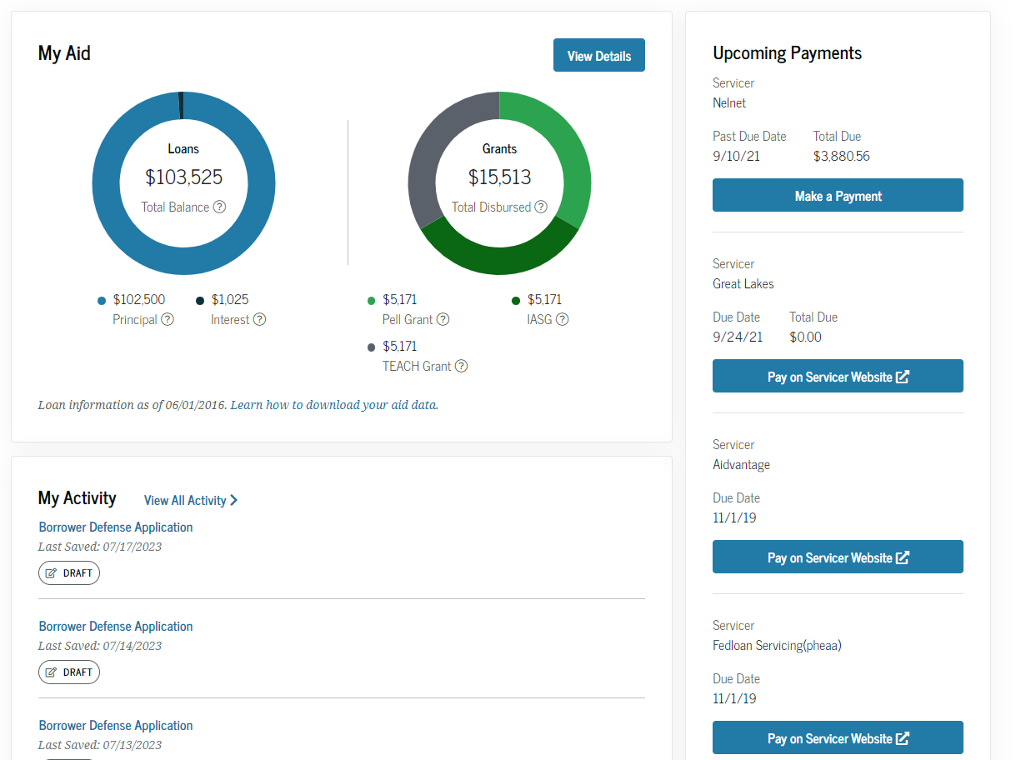
STUDENT AID DASHBOARD OVERVIEW
My Aid
Displays the total loan and grant amount
Servicer Information and Upcoming Payments
Breaks down payments by amount and servicer(s).
My Activity
Includes current outstanding actions such as borrower defense or PSLF application statuses.

Slide 20
INCOME-DRIVEN REPAYMENT

Slide 21
INCOME-DRIVEN REPAYMENT (IDR) PLANS
IDR plans calculate monthly payment amounts based on income and family size.
Eligible borrowers will have their loans forgiven if they have been in repayment for 20 years (240 months) or 25 years (300 months).
Borrowers must recertify their income every year to stay on an IDR plan.
Plans
Saving on a Valuable Education (SAVE) Plan (formerly REPAYE)
Pay As You Earn (PAYE) Plan
Income-Based Repayment (IBR) Plan
Income-Contingent Repayment (ICR) Plan

Slide 22
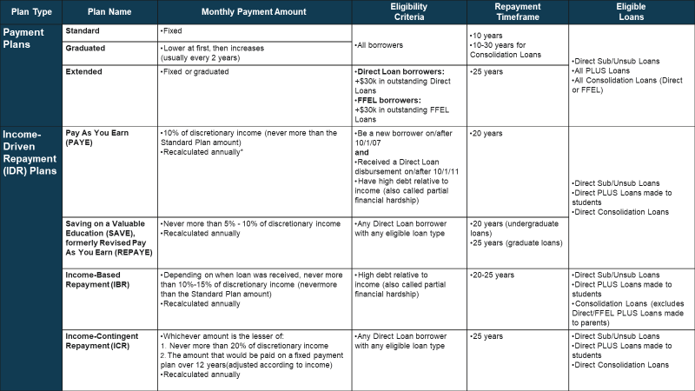
IDR DETAILS

Slide 23
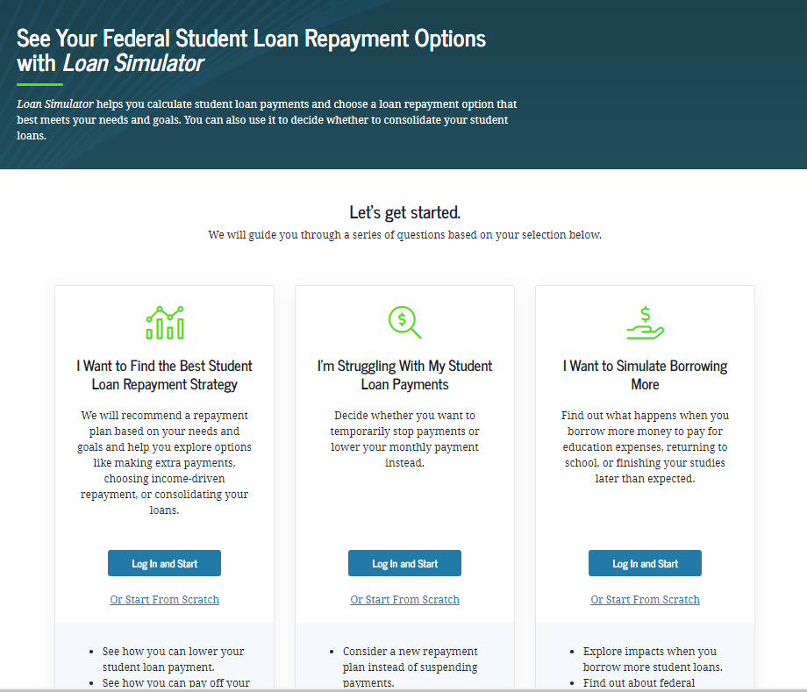
LOAN SIMULATOR
Loan Simulator | Federal Student Aid
Use Loan Simulator To Find the Right Repayment Plan for You (youtube.com)
Loan Simulator helps calculate student loan payments and choose a loan repayment option that best meets a borrower’s needs and goals.

Slide 24
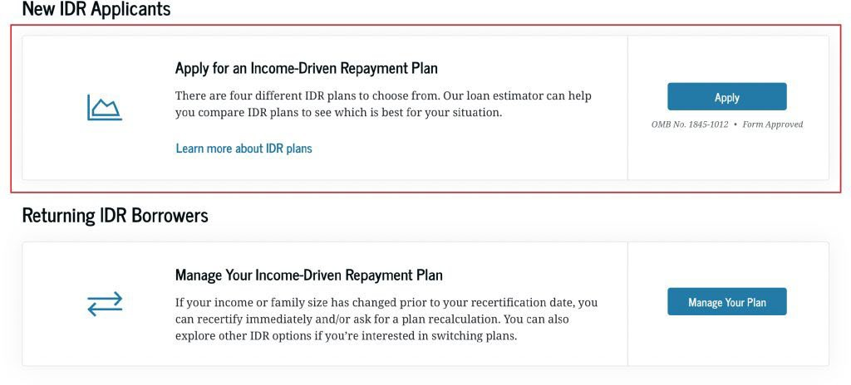
APPLY FOR IDR
Adsf

Slide 25
IDR RESOURCES
Income-Driven Repayment Plans | Federal Student Aid
Apply for or Manage Your Income-Driven Repayment Plan | Federal Student Aid
Your Guide to Student Loan Repayment Plans (youtube.com)

Slide 26
THE SAVING ON A VALUABLE EDUCATION (SAVE) PLAN

Slide 27
SAVE BASICS
The SAVE Plan replaced the Revised Pay As You Earn (REPAYE) Plan.
Borrowers that were on the REPAYE Plan have been automatically added to the SAVE Plan and are receiving the benefits of the new plan. No further action is needed.
The SAVE Plan, like other IDR plans, calculates monthly payment amounts based on income and family size and typically offers lower monthly payments compared to the other IDR plans.
Must have Direct Loans. (Not eligible: Parent PLUS, FFEL, Perkins)

Slide 28
SAVE BENEFITS
Lower Monthly Payments
Single borrowers earning $32,800 or less and families of four earning $67,500 or less will have $0 monthly payments.
Interest Subsidy
Once a borrower pays what they owe on their loans, they’ll no longer see their loans grow due to unpaid interest.
No Interest Capitalization
When borrowers switch from a different IDR plan to the SAVE Plan, interest on loans won’t be added to the principal balance, unless they are switching from the Income-Based Repayment (IBR) Plan.
Spousal Income Exclusion
Spousal income is excluded for borrowers who are married and filing taxes separately, removing the need for spouses to cosign an IDR application.

Slide 29
EARLY SAVE FORGIVENESS
Starting in February 2024, if borrowers are enrolled in the SAVE Plan, their loans might be eligible for forgiveness after as few as 10 years of monthly payments, rather than 20 or 25 years.
Eligibility for this shortened repayment term depends on how much they borrowed to attend school.

Slide 30
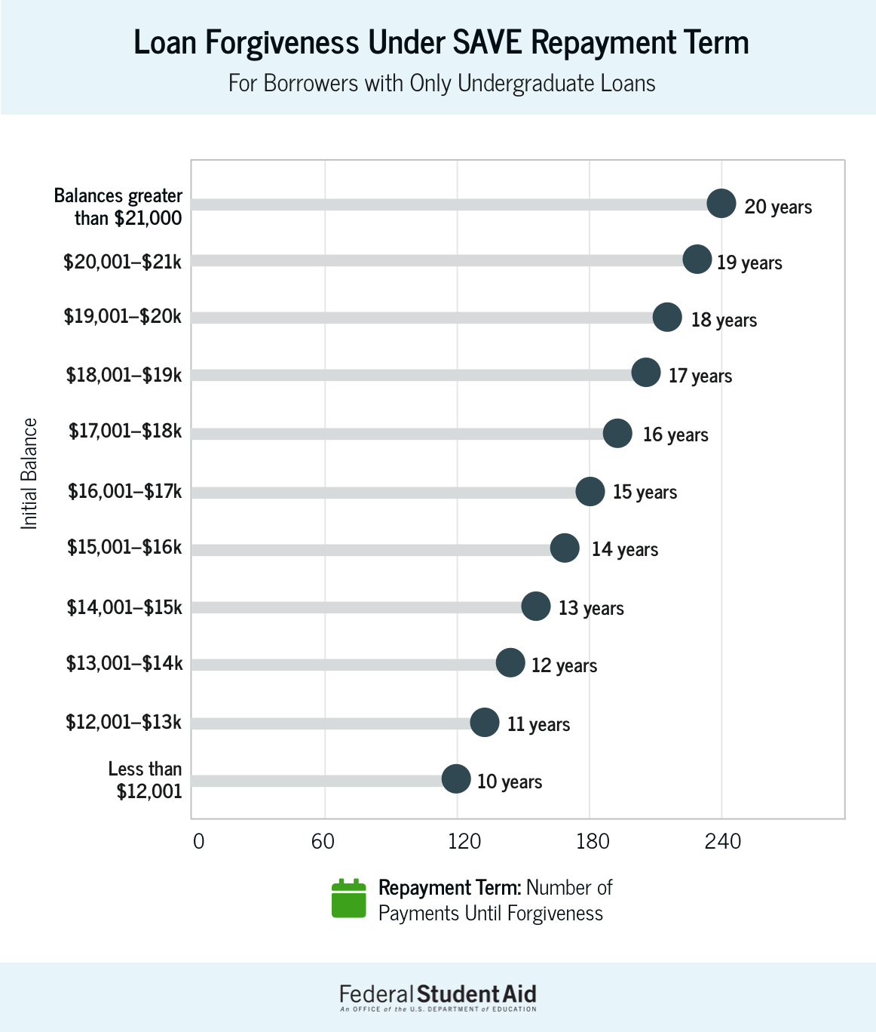
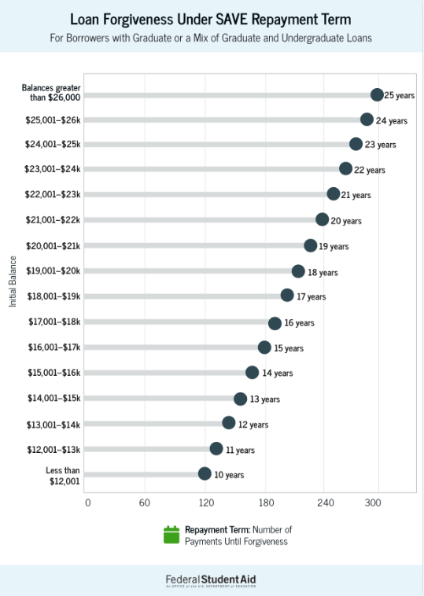

Slide 31
SAVE RESOURCES
The Saving on a Valuable Education (SAVE) Plan Offers Lower Monthly Loan Payments | Federal Student Aid
Biden-Harris Administration Releases State-by-State Breakdown of $1.2 Billion in SAVE Plan Forgiveness | U.S. Department of Education
Saving on a Valuable Education (SAVE) Plan - The New Income-Driven Repayment Plan (youtube.com)

Slide 32
PAYMENT COUNT ADJUSTMENT

Slide 33
ONE-TIME PAYMENT COUNT ADJUSTMENT
On April 19, 2022, the U.S. Department of Education (ED) announced updates to Income-Driven Repayment (IDR) plans.
Under the one-time revision, past inaccuracies, forbearance steering, and deferments will be addressed. Borrowers may receive credit for past periods of repayment, forbearance, and deferment that would otherwise not qualify for IDR or for PSLF.
This change applies to all borrowers with ED-held loans, including borrowers in default and Parent PLUS borrowers. FFEL and Perkins borrowers can consolidate into the Direct Loan program by April 30, 2024 to benefit from the adjustment.
Borrowers are already getting the payment count adjustment. The last adjustment will be performed in July 2024.
Payment Count Adjustments Toward Income-Driven Repayment and Public Service Loan Forgiveness Programs | Federal Student Aid

Slide 34
ACCOUNT ADJUSTMENT BENEFITS
Payment Counts | Automatic Forgiveness | Consolidate Non-Eligible Loans | Overpayment
Any months in a repayment status, regardless of the payments made, loan type, or repayment plan Any time in repayment prior to consolidation on consolidated loans Time in certain forbearances and deferments | Borrowers with loans that have accumulated time in repayment of at least 20 or 25 years will see automatic forgiveness, depending on their loan type, even if they are not currently on an IDR plan. | Borrowers who have commercially managed FFEL, Perkins, Health Education Assistance Loan (HEAL) Program, or other non-Direct Loan loans should apply for a Direct Consolidation Loan by April 30, 2024 to get the full benefits of the one-time account adjustment. | Borrowers made qualifying payments on Direct Loans that exceed forgiveness thresholds will receive a refund for their overpayment.

Slide 35
DEFERMENTS & FORBEARANCES
What automatically counts?
Long-term forbearances (12+ months consecutive/36+ months cumulative)
Deferments prior to 2013 (except in-school)
Economic Hardship Deferments (not unemployment deferment)
Some military-related forbearances and deferments
**Short-term forbearances – process TBD (not automatic)

Slide 36
PAYMENT COUNTING
ONE-TIME PAYMENT COUNT ADJUSTMENT INCLUDES:
Any months in a repayment status regardless of the payment made, loan type or repayment plan.
Excludes periods in default
Any time in repayment prior to consolidation, on consolidation loans:
Includes loans that have been consolidated multiple times
Includes consolidated Direct Loans
Includes consolidated FFEL and Perkins loans
Select forbearances and deferments

Slide 37
PSLF + PAYMENT COUNT ADJUSTMENT
Payment Count Adjustment will benefit PSLF borrowers
For borrowers who consolidate before the adjustment, their PSLF payment count may temporarily set to 0.
Following recount, all periods after October 2007 will be credited toward IDR will also be credited toward PSLF for eligible loans and periods where the borrower certifies public service employment.

Slide 38
LOAN CONSOLIDATION

Slide 39
CONSOLIDATION
Converts or combines one or more loan into a Direct Consolidation Loan
Ex: FFEL + Direct Loans = Direct Consolidation Loan
Ex: Parent PLUS + Perkins = Direct Consolidation Loan
Ex: FFEL Consolidation > Direct Consolidation Loan

Slide 40
CONSOLIDATING FOR THE ADJUSTMENT
Loans that will get the adjustment:
Direct Loans, including consolidation loans and Parent PLUS
ED-held Federal Family Education Loan (FFEL) program loans
Loans that must be consolidated to get the adjustment:
Perkins
Commercially-held FFEL
Health program loans (HEAL, LDS – Loans for Disadvantaged Students)
CONSOLIDATE BY APRIL 30, 2024

Slide 41
TIPS ON CONSOLIDATING
Here are a few things borrowers should know before consolidating:
The principal balance might go up. When consolidating, the outstanding interest gets added to the principal.
The new consolidation loan will generally have a new interest rate. The new rate could be lower or higher for some loans.
If borrowers consolidate by April 30, 2024, they will not lose credit towards IDR or PSLF forgiveness.
Consolidation process takes 60-90 days.
Borrowers don’t have to consolidate all their federal student loans.

Slide 42
CONSOLIDATION AFTER APRIL 30
Beginning July 2024:
SAVE: Borrowers who consolidate will receive credit for a weighted average of payments that count toward forgiveness of the loans being consolidated.
PSLF: If borrowers consolidate, the qualifying payments made on the Direct Loans (other loan types will not be considered) included in the consolidation loan will be credited to the consolidation loan using a weighted average of those payments.
For example, a borrower with 60 qualifying payments on a Direct Loan with a balance of $30,000 who consolidates their loan with another Direct Loan with a balance of $30,000 with zero qualifying payments will have a new qualifying payment count of 30 payments credited to the new consolidation loan.

Slide 43
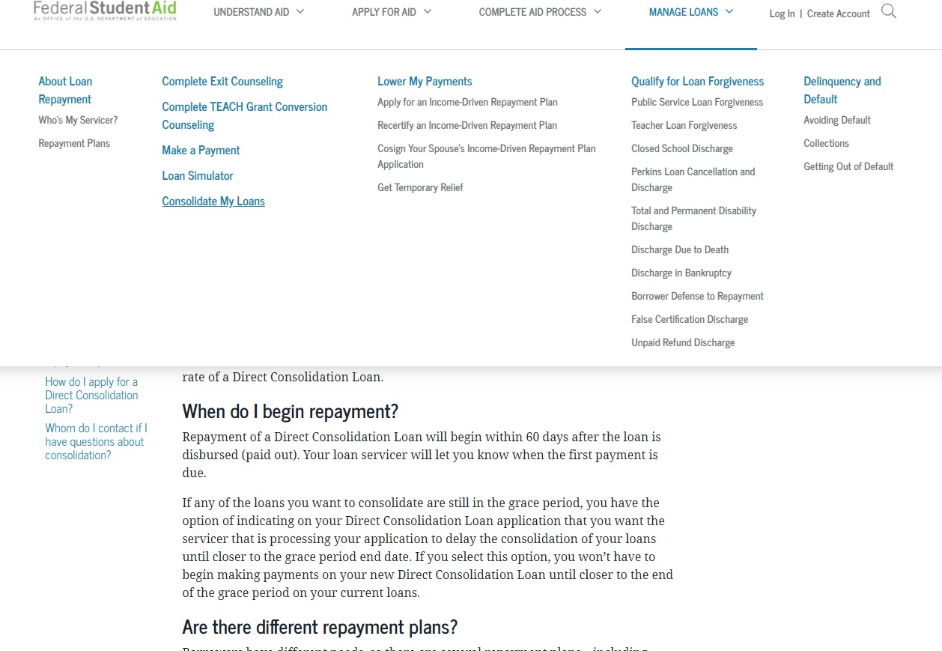
THE CONSOLIDATION APPLICATION
To submit the Direct Consolidation Loan Application electronically, visit Student Loan Consolidation | Federal Student Aid
From the StudentAid.gov homepage:
Select Manage Loans from the top navigation menu or from the site footer
Select Consolidate My Loans

Slide 44
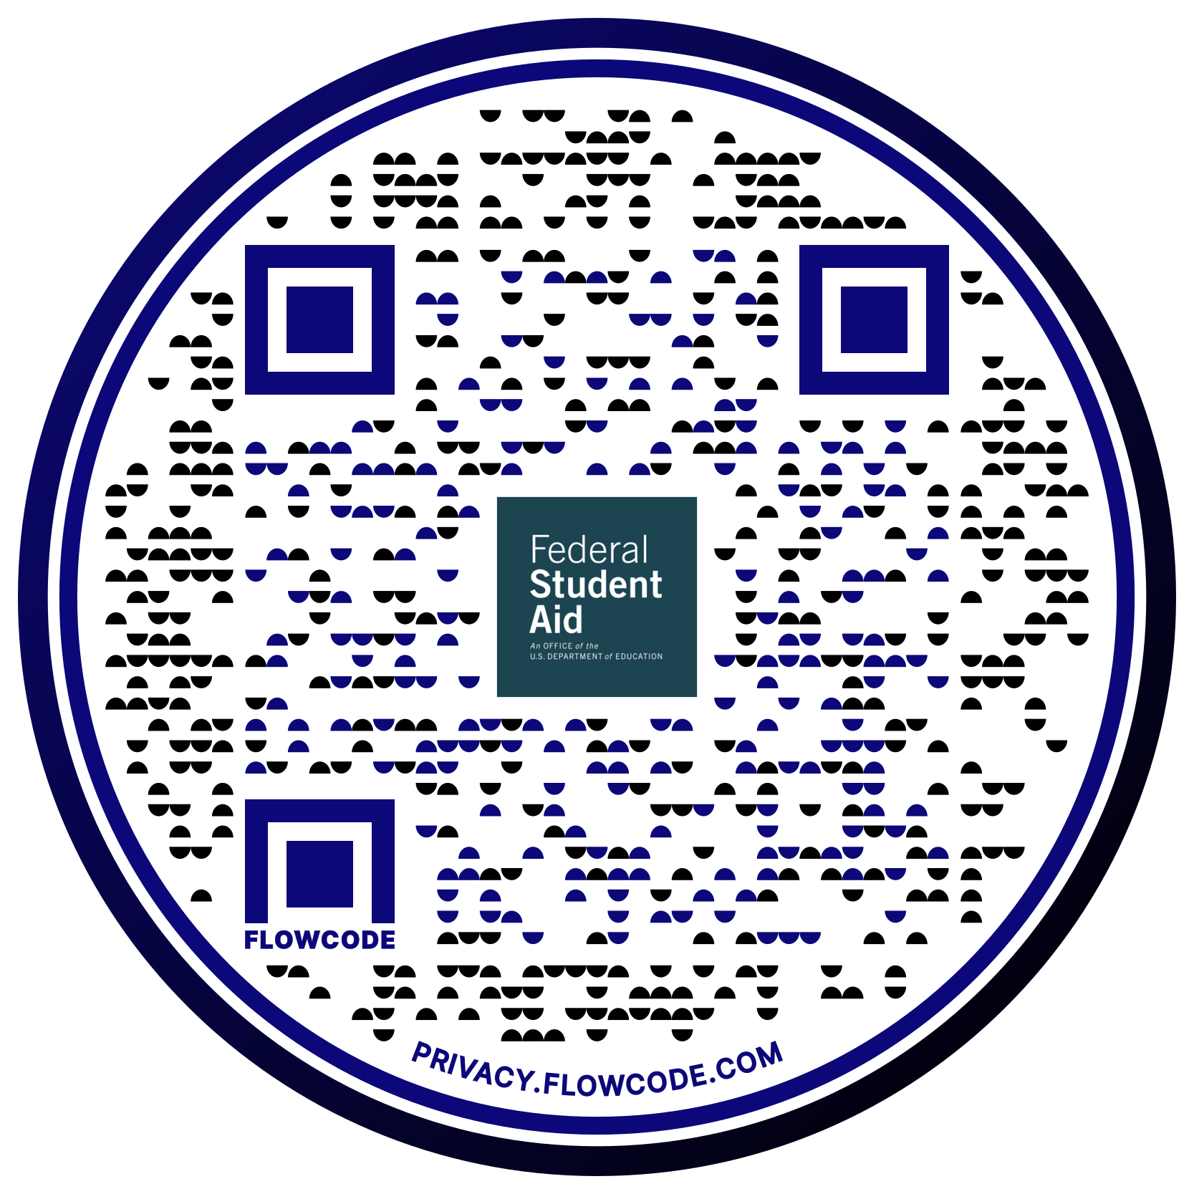
PUBLIC SERVICE LOAN FORGIVENESS (PSLF)
StudentAid.gov/publicservice

Slide 45
PSLF BASICS
120 qualifying payments…
While working for a qualifying employer
Forgiven amount is not taxable income
…on Direct Loans…
…when applying for PSLF

Slide 46
PSLF BASICS: QUALIFYING LOAN TYPE
Eligible:
Direct Loans, including:
Consolidation Loans
Parent PLUS Loans*
Not Eligible
FFEL Program Loans
Perkins Loans
Any other federal or private student loan

Slide 47
PSLF BASICS: QUALIFYING EMPLOYMENT
Full-time (30 hours/week)
Government (including military)
All 501(c)3 non-profits
Some limited exceptions
Part-time work that does not add up to full-time
Volunteer work
For-profit entities
Labor unions
Contractors

Slide 48
QUALIFYING EMPLOYMENT
Enter the EIN from the W-2 to see if the employer is eligible for PSLF:
Public Service Loan Forgiveness Employer Search | Federal Student Aid
If the employer is showing as ineligible or undetermined, review these guidelines:
Public Service Loan Forgiveness Reconsideration | Federal Student Aid

Slide 49
PSLF BASICS: QUALIFYING REPAYMENT PLAN
Standard 10-year Repayment
Any IDR plan (SAVE, PAYE, ICR, IBR)
Certain periods of forbearance or deferment
In a Graduated, Extended, or Alternative plan
In-school deferment or grace periods

Slide 50
PSLF BASICS: DEFERMENTS AND FORBEARANCES
PSLF-eligible Deferments and Forbearances:
Cancer treatment deferment
Economic hardship deferment
Military service deferment
Post-active-duty student deferment
AmeriCorps forbearance
National Guard Duty forbearance
U.S. Department of Defense Student Loan Repayment Program forbearance
Administrative forbearance (related to servicer processing)
Mandatory administrative forbearance (related to national emergencies)

Slide 51
PSLF BASICS: 120 QUALIFYING PAYMENTS
Payments for full amount due
Can be non-consecutive
Multiple payments in less than the amount due may be counted if all smaller payments satisfy the amount due
Lump sum payments will be counted as eligible
Limited to 12 months or payments or until IDR plan recertification date, whichever comes first
For Americorps, Peace Corps, and DoD, lump sum payments now count as a go-forward payment
Notes:
Say but take out slide

Slide 52
APPLYING FOR PSLF
New, simplified form available
Log in with FSA ID
Digital signature options when submitting through SA.gov
Public Service Loan Forgiveness (PSLF) Help Tool | Federal Student Aid
Borrowers will need:
EIN from W-2
Contact person’s email address at the current/past employer who is authorized to verify employment
Notes:
Say but take out slide

Slide 53
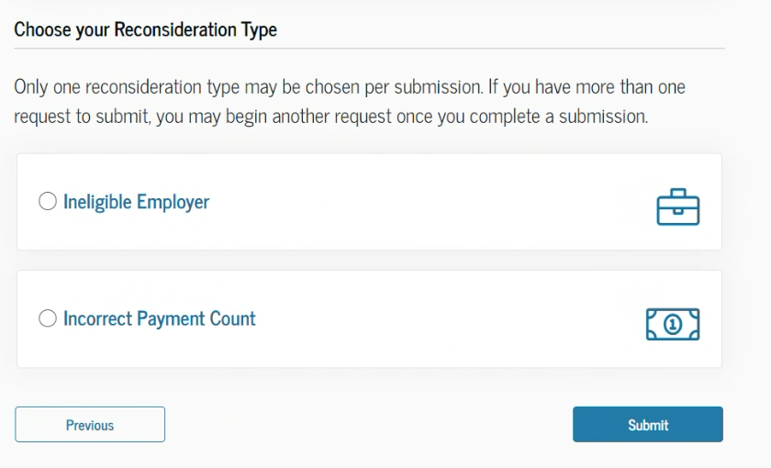
PSLF RECONSIDERATION
If a borrower believes the Department made a mistake in determining that their employer(s) or payment(s) did not qualify for PSLF, they may submit a request for reconsideration.

Slide 54
PARENT PLUS LOANS

Slide 55
PARENT PLUS & PSLF
Parent PLUS Loans are eligible for PSLF
They are not eligible for IDR plans
Parent PLUS borrowers can consolidate to become eligible for one IDR plan: Income-Contingent Repayment (ICR)

Slide 56
WHO GETS FORGIVENESS?
Parents are eligible for PSLF for the loans in their name
Children are eligible for PSLF for the loans in their name
A parent cannot apply their PSLF eligibility to the child

Slide 57
FRESH START

Slide 58
DELINQUENCY AND DEFAULT
The first day after a missed student loan payment, the loan becomes past due, or delinquent.
If delinquent for 90 days or more, the loan servicer will report the delinquency to the three major national credit bureaus.
For Direct Loan and FFEL, borrowers are considered to be in default if they don’t make the scheduled student loan payments for at least 270 days.
The entire unpaid balance of the loan and any interest owed becomes immediately due.
Wages may be garnished.
Tax refunds and federal benefit payments may be withheld.
They lose eligibility for additional federal student aid.
Notes:
Say but take out slide

Slide 59
FRESH START: BENEFITS
One-time, temporary program that offers every federal student loan borrower a path out of default
Benefits:
Restored access to federal aid
Stopped collections
Eligibility for other government loans
Credit report changes
Preserved date of first delinquency
CFPB reports that borrowers see a 50-point jump in credit scores
Borrowers should take advantage of Fresh Start by September 30, 2024.
Notes:
Say but take out slide

Slide 60
FRESH START: HOW TO SIGN UP
Steps to take advantage of Fresh Start:
Phone—Call the U.S. Department of Education at 1-800-621-3115 (For deaf or hard of hearing, the TTY number is 1-877-825-9923
Online—Go to Debt Resolution Federal Student Aid
Mail—Write to P.O. Box 5609, Greenville, TX 75403
After opting into Fresh Start, borrowers will receive information about income-driven repayment and their loans will be transferred to standard servicing.
A Fresh Start for Federal Student Loan Borrowers

Slide 61
GETTING HELP

Slide 62
RESOURCE LINKS
Visit Home | Federal Student Aid
Contact your servicer: Who’s My Student Loan Servicer? | Federal Student Aid
For help with the loan consolidation application or FSA ID: Federal Student Aid Information Center (FSAIC) | Help Center
Submit a complaint: Submit a Complaint (studentaid.gov)

Slide 63
Questions

Slide 64
FINRED Digital Resources
Visit the FINRED website at https://finred.usalearning.gov for original, reliable and up-to-date financial information you can count on.
Discover MilSpouse Money Mission resources including:
With Sen$e, find helpful information to:
Prepare for transitions throughout your military career.
Make wise financial decisions when life events happen.
Thrive while spending within your means.
Money Ready curriculum
MilLife Milestones
Videos
Blogs
Resources
https://www.milspousemoneymission.org
Sign up at https://finred.usalearning.gov/eNews-subscriber for our eNewsletters, which are tailored for:
Service members and families
Service providers
Spouses
Follow @DoDFINRED on social media:
We’ve got your back. What you need to know is always a click away!

Slide 65
Continuing Education
This webinar has been approved for 1.5 continuing education (CE) credit hours from the following:
Evaluation Link
The American Association for Family and Consumer Sciences (AAFCS)
The Association for Financial Counseling & Planning Education (AFCPE)
The Center for Financial Certifications (FinCert.org)
The National Council on Family Relations (NCFR)
OneOp Certificates of Attendance
Go to the event page for the evaluation and post-test link.
Questions?
Email us at OneOpPersonalFinance@gmail.com
OneOp.org/learn/160031/

Slide 66
Upcoming Webinar
RSVP on the webinar event page!
WIC at 50 Years: Honoring
the Past, Nourishing the Future
Tuesday, July 16, 2024 at 11 am ET - 12:30 pm ET
Discover the history of WIC and the impact of WIC on maternal and child health over the past 50 years.
Describe the WIC food packages, how they have evolved, and the most recent changes.
Identify innovations that support the future of WIC as the premiere public health program.
Continuing education credits are available!
OneOp.org/learn/160044/

Slide 67
Connect with OneOp
Explore upcoming events, articles, resources, and more!
OneOp.org

